Slide 1
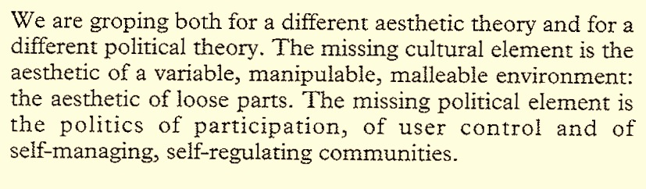
A MISSING CULTURAL ELEMENT:
AN EMPTY SPACE (THE MUSEUM) TO THINK AND TALK ABOUT CULTURE
COLIN WARD
Talking to Architects

Slide 2
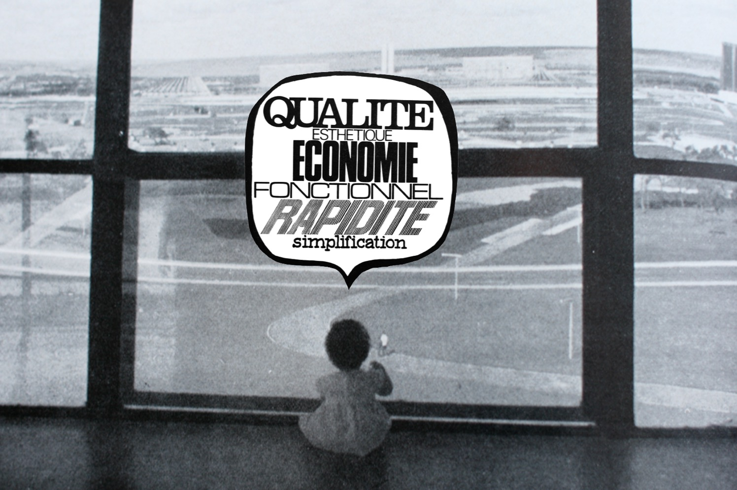
PLANNING, WHAT FOR ?
Granddaughter of LUCIO COSTA URBANIST of BRAZILIA
PLAN IS A LANGUAGE AND IT IS SOMETIMES
A KIND OF HUMAN ANALPHABETISM

Slide 3
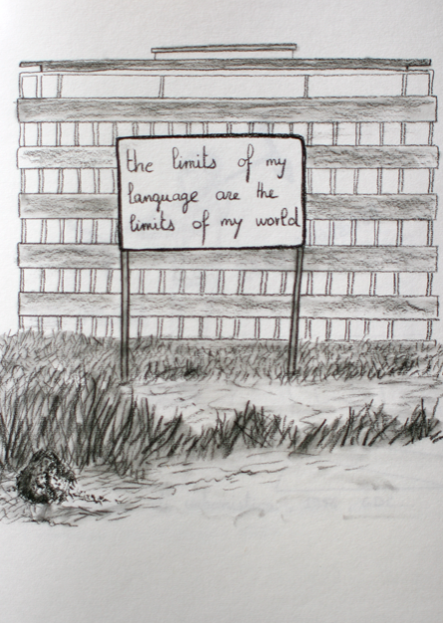
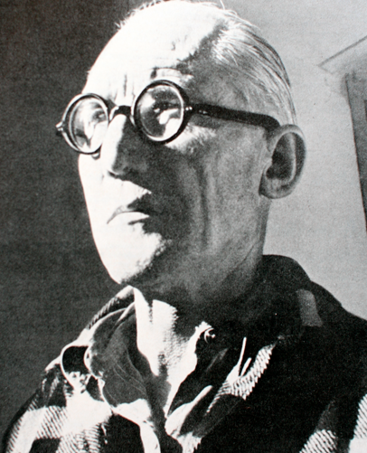
THE PLANNER
THE ARCHITECT
THE INTELLECTUAL

Slide 4
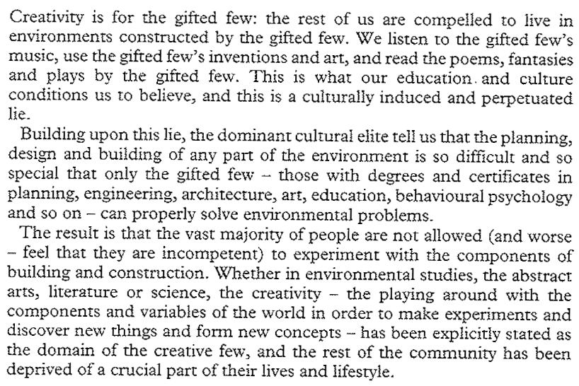
SIMON NICHOLS In Colin Ward: Talking to Architects

Slide 5
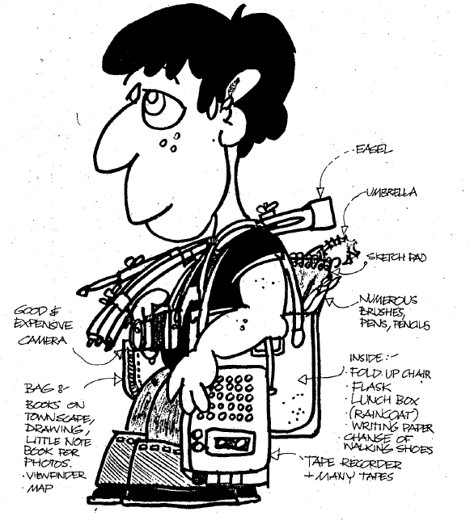
Seeking my / a history
of Cosmo-city
Who will be interested ?
How will my story
be archived ?
In: EILEEN ADAMS & COLIN WARD, 1980

Slide 6
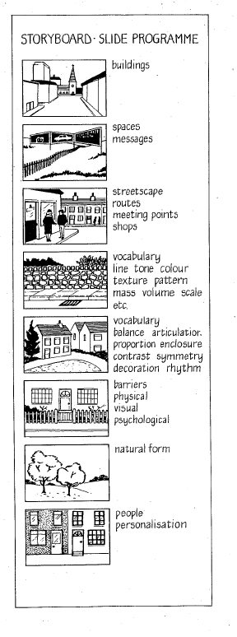
STORYBOARD: personnal point of view …
WHAT ABOUT THE BUILDINGS ?
SPACE MESSAGE ?
STREETSCAPE, MEETINGPOINTS, SHOPS ?
VARIETY OF DETAILS: MATERIALS, TEXTURES, TONES…
ARTICULATION BETWEEN THE ELEMENTS ?
FRONTIERS, EVIDENT
OR NOT ?
PHYSICAL, VISUEL, PSYCHOLOGICAL
NATURE, GARDENING ?
PERSONALISATION
OF BUILDINGS, ELEMENTS OF THE CITY?
In: EILEEN ADAMS & COLIN WARD, 1980

Slide 7
MEETING POINTS
VISUAL HISTORY OF APPROPRIATION
THROUGH INHABITANTS
WHAT IS WORKING OR NOT IN THE WAY THE CITY IS PLANNED?
VISUAL HISTORY OF FEAR AND VIOLENCE
….
VISUAL INVESTIGATIONS

Slide 8
David Lowenthal
Walk Questionnaire
(1972)
Townscape Notation
In: Art and the Built Environment
Colin Ward / Eleen Adams

Slide 9
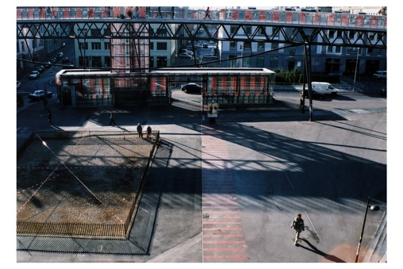
What i feel…about a PLACE
possession
advantage
viscosity
enclaves
enclosure
focal point
precinct
indoor landscape
outdoor room
multiple enclosure
insubstantial space
defining space
looking out
thereness
here and there
pinpointing
truncation
change of level
netting
silhouette
grandiose vista
division of space
handsome gesture
closed vista
deflection
projection and recession
incident
punctuation
narrows
fluctuation
undulation
closure
recession
anticipation
infinity
mystery
the maw
linking and joining
pedestrian ways
continuity
hazards
….
UNDERLINE !
Place de L’Europe,Yves Mettler, 2013
In: EILEEN ADAMS & COLIN WARD, 1980

Slide 10
What i feel…about it’s CONTENT
juxtaposition
immediacy
thisness
detail
secrecy
urbanity
intricacy
propriety
bluntness and vigour
entanglement
nostalgia
exposure
intimicy
illusion
metaphor
tell tale
animism
absence
signifiant objects building as sculpture geometry
multiple use
foils
relationships
scale
distorsion
natural form calligraphy
publicitiy
….
UNDERLINE !
Parking, Genova, Tilo Steireif, 2014
In: EILEEN ADAMS & COLIN WARD, 1980

Slide 11
What i feel…about it’s FONCTION
FONCTION
structure
barriers
steps
black and white
solid and void
texture
lettering
trim
roads
kinetic unity
public and private
water
….
UNDERLINE !
Stadium beneath the prison, Genova,
Tilo Steireif, 2014
In: EILEEN ADAMS & COLIN WARD, 1980

Slide 12

line
colour
texture
shape
mass
volume
space
contrast
pattern
rythm
balance
light
movement
time
direction
scale proportion
imbalance
symmetry
asymmetry
illusion allusion variety character
consistency identity
unity
height
width
depth projection
recession progression
manipulation enrichemnt decoration accent articulation expansion
contraction enclosure definition
barrier
level
accent
decoration boring interesting exciting
vital
dominant destructive inviting
positive threatened complementary varied harmonious
UNDERLINE !
What i feel…about a street, a house,
a shop…

Slide 13

sensitive awkward convicing comfortable enhancing ostentatious thoughtful subtle claustrophobic bland
ordinary elegant
weak
pleasant
discordant
powerful unconvincing monotonous decrepit
exploited
renovated rehabiliated
contemporary modern traditional restored reconstructed modified adapted restricted varied
similar
hidden retrained
local
vernacular
simple undulating vertical horizontal straight
curved
intimate
open
exposed limited
regular uniforme repetitive
What i feel… about a street, a house,
a shop…
UNDERLINE !

Slide 14
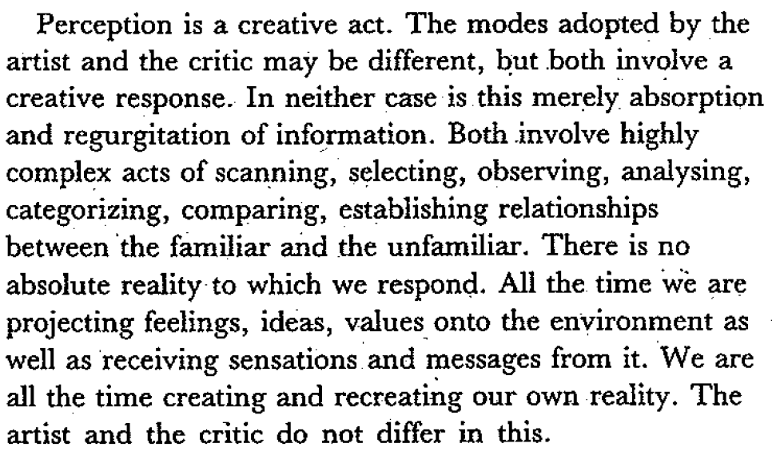

Slide 15
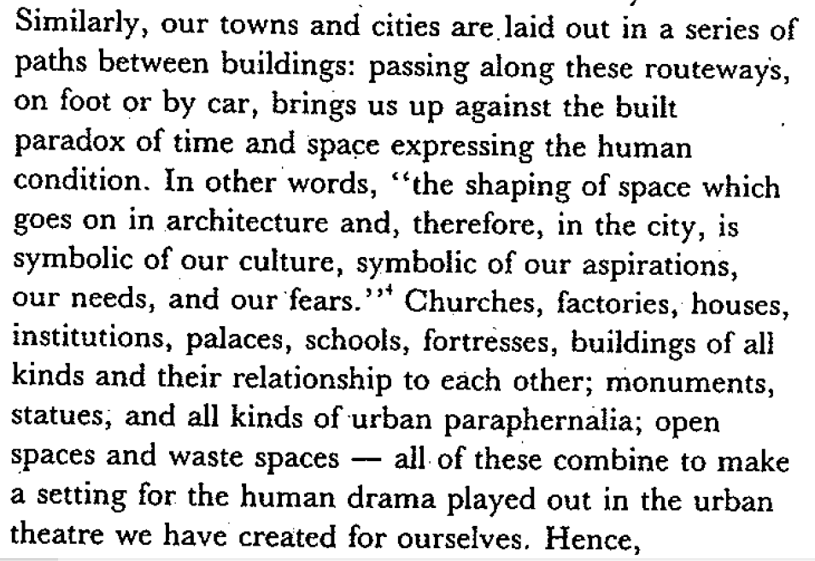

Slide 16
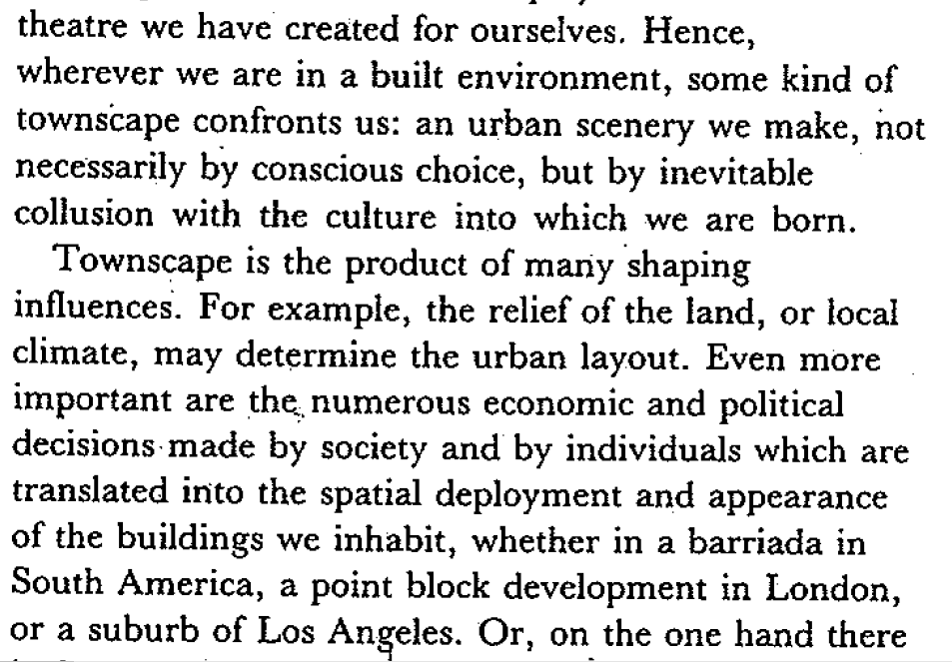
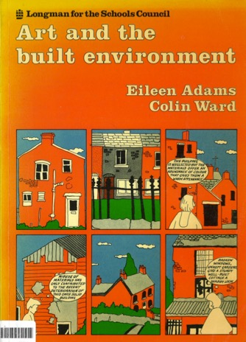
EILEEN ADAMS & COLIN WARD, 1980

Slide 17
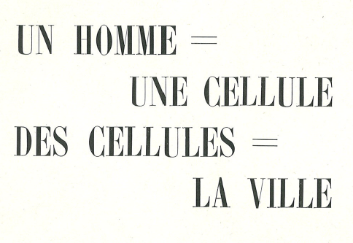
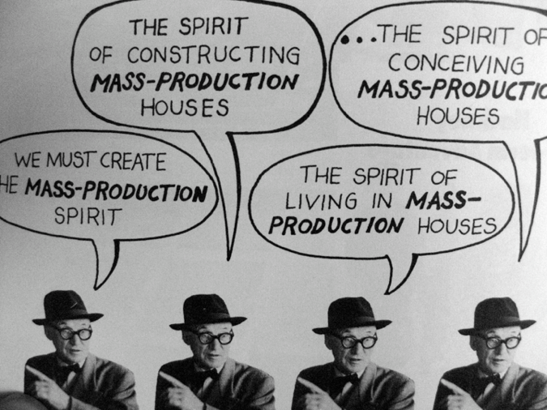
LE CORBUSIER
COLIN WARD, UTOPIA (COLLAGE)

Slide 18
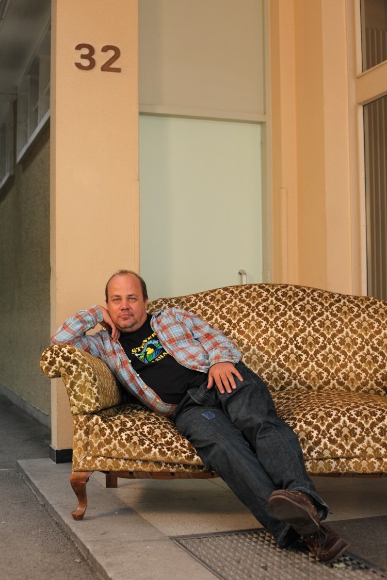
« With Melano,
we were wondering
why people in Geneva
know only a few
neighbours »
Collective Project
60x60
During the neighbourg day
June 2011

Slide 19
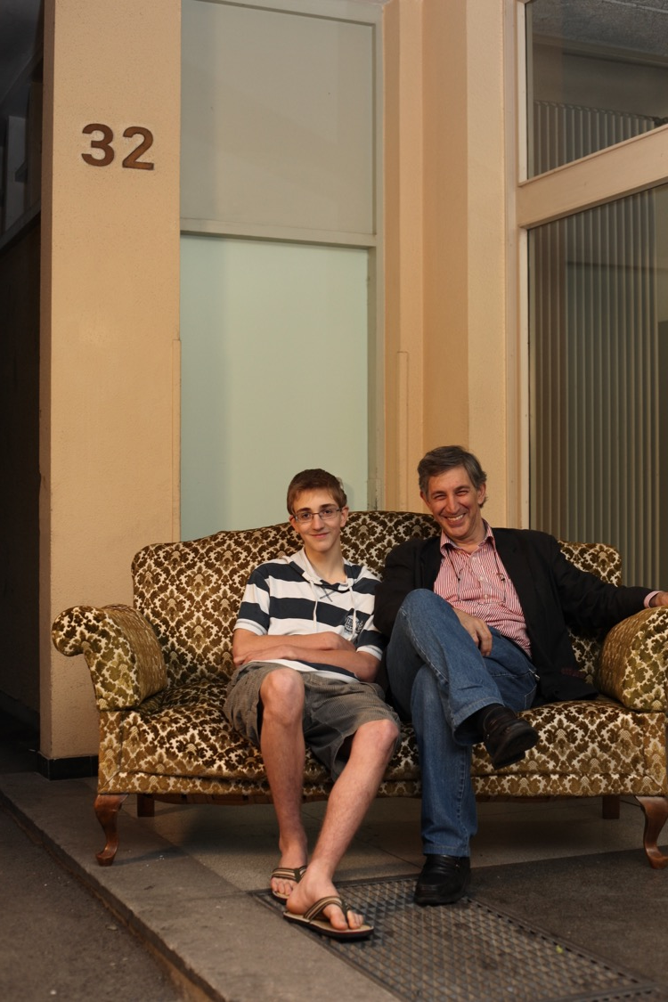
First floor: Nato - Mother and two children Maia and Dato. Father died in the war in Abkhazia. Second Floor: Mother Nino, Father Giorgi, Yang family with one little daughter - Tamuna. Third Floor: Father - Thengiz, Mother - Tamar. Family with two children: Irakli and Sopho. My first Platonic love with Irakli :) Forth Floor: Father - Nugzari, Mother - Mtvarisa. Family with two children: Salome and Kakha. Fifth floor was closed for a years. Family moved in Russia. Sixth Floor: My Family. Me my Brother, mother and Father. Seventh floor: Family from the small village. Mother - Lamara, father Temuri and two children: Nato and Giorgi. All of them my friends and close people.
Melano Sokhadze’s
Inventory

Slide 20
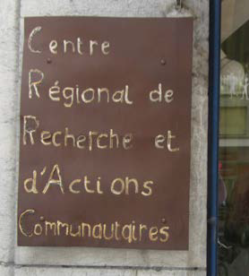
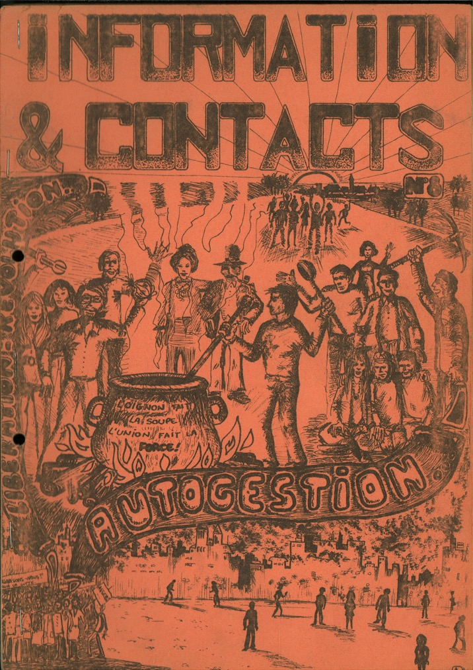
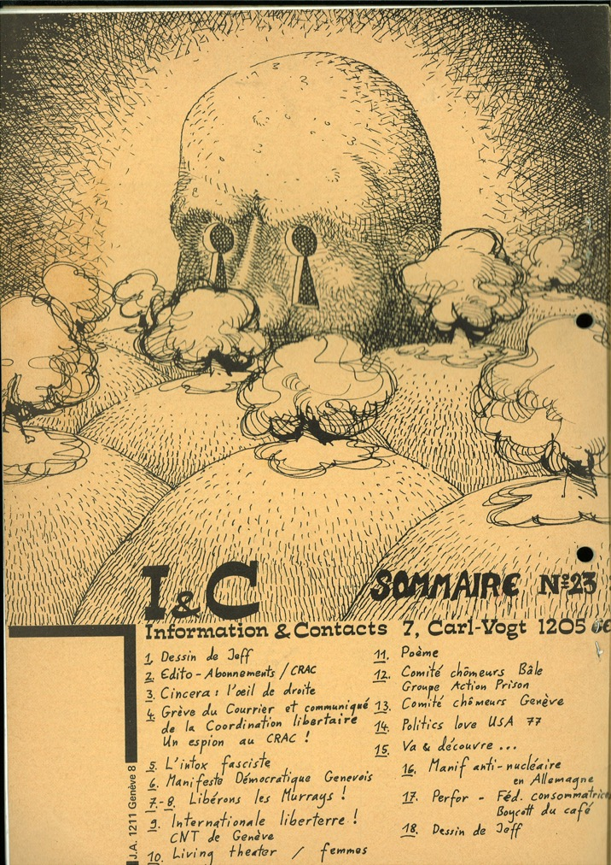
Anarchist & Squatters in Geneva, 1970-80
Source: Ivar Peterson, from the CRAC

Slide 21
Franco Moretti : Atlas du roman européen (1800-1900), essai
Atlas of European Novels
Paris of Balzac, Flaubert, Zola ;
London city of Jane Austen, Charles Dickens, Conan Doyle.
Invent a Novel
Beginning with
Mapping Cosmo –city and surrounding’s
Then imagine some characters
>>>> linked to a drama, a comedy, a thriller
Personal stories and experiences can be added

Slide 22
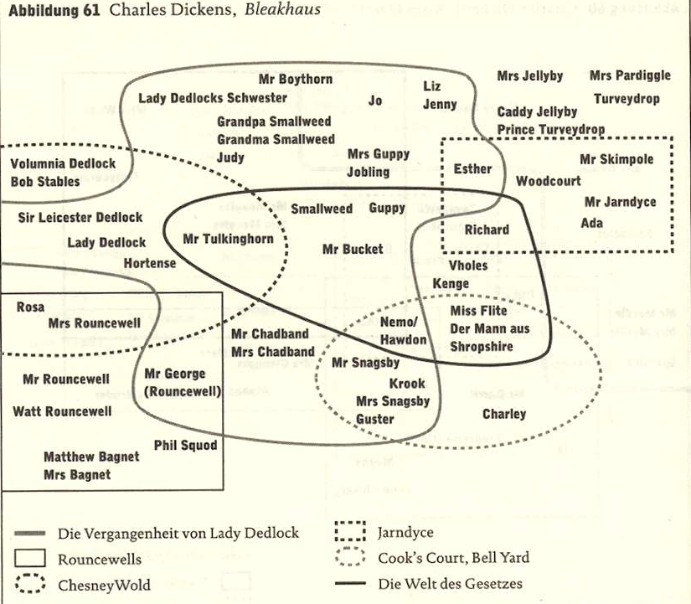
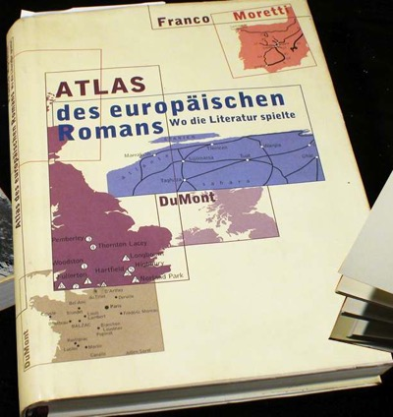
Charles Dickens

Slide 23
MAPPING
Moves in a town of a person / a community:
Moves between home and work,
Moves between home and grocery or market
Moves between one house to another (moving out from one quarter, town to another)
Escape… or get closer to someone
the whole series of past events connected with someone’s profession and the map:
Love affairs, fly the nest, wedding, having kids,
Places of happiness, places of painfull or bad memories
Map of discussions places
Map of crimes, of stories related through newspaper
Map of newcomers: where do they come from
http://www.literaturatlas.eu

Slide 24
Colin Ward, 2011, Anarchy in Milton Keynes
The Anarchist Library, Anti-Copyright, March 11,
Anarchist movements
(…) the voluntary associations
which already now begin to cover all the fields of
human activity would take a still greater extension so as to
substitute themselves for the State in all its functions.
They would represent an interwoven network, composed of an
infinite variety of groups and federations of all sizes and
degrees, local, regional, national and international — temporary
or more or less permanent — for all possible purposes:
production, consumption and exchange, communications,
sanitary arrangements, education, mutual protection, defence
of the territory, and so on; and, on the other side, for
the satisfaction of an ever increasing number of scientific,
artistic, literary and sociable needs.”

Slide 25
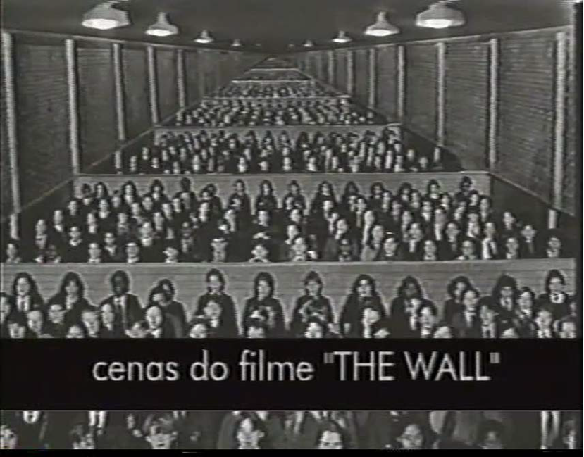
ROBERTO
FREIRE
(1927 - 2008)
was a medical
psychiatrist and
brazilian writer,
who created
SOMATHERAPY
(Sau Paolo, Brazil) EXTRAIT DU FILM DU CIRA « PEDAGOGIA
LIBERTARIA, LIBERTADE NO COTDIANO » / SAMPA
1996, SAO PAULO, COLLECTIVO ANAQUISTA
BRANCALEONE

Slide 26
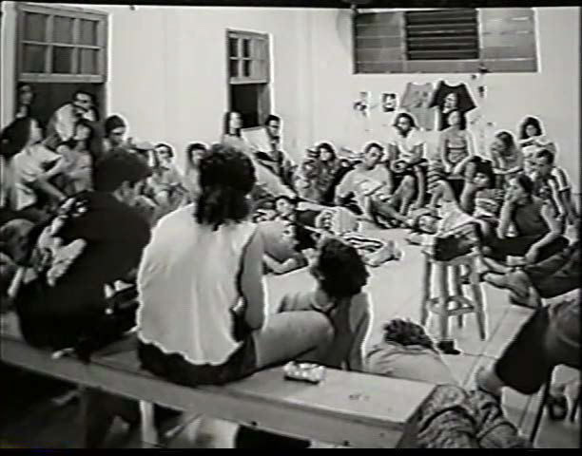
Soma therapy & anarchism
4 Elements: 1) Meeting of teenager without any teacher. The Teenagers have to confront themselves alone.
2) Capoeira Angola: canalizing energy through art & dance with physical contacts.
3) Choice of group activities for fun or in a collective work
4) Based on Wilhelm Reich theory: neurosis is not only in the head but also in the body.

Slide 27
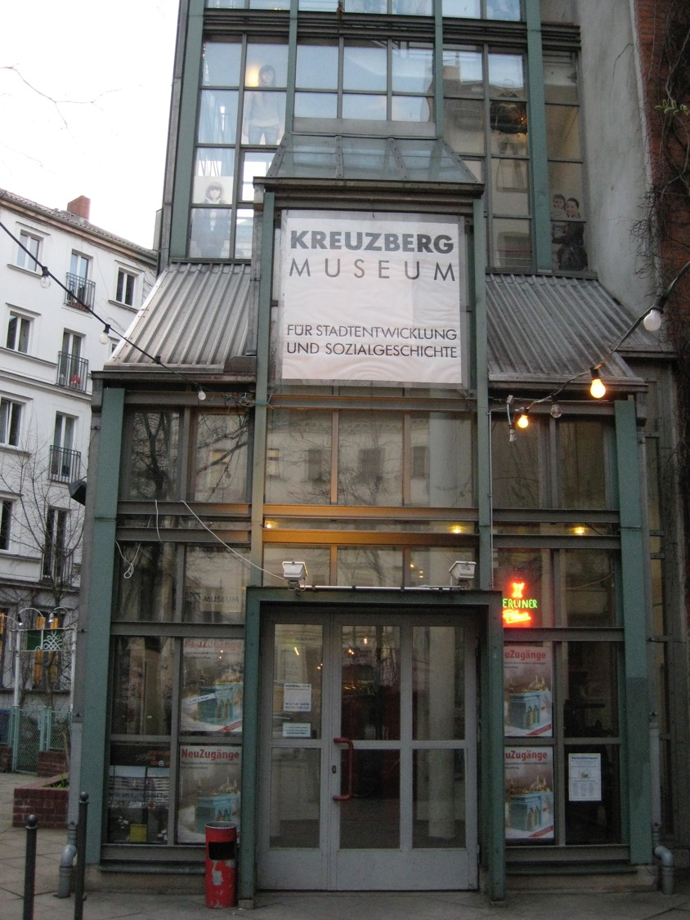

Slide 28
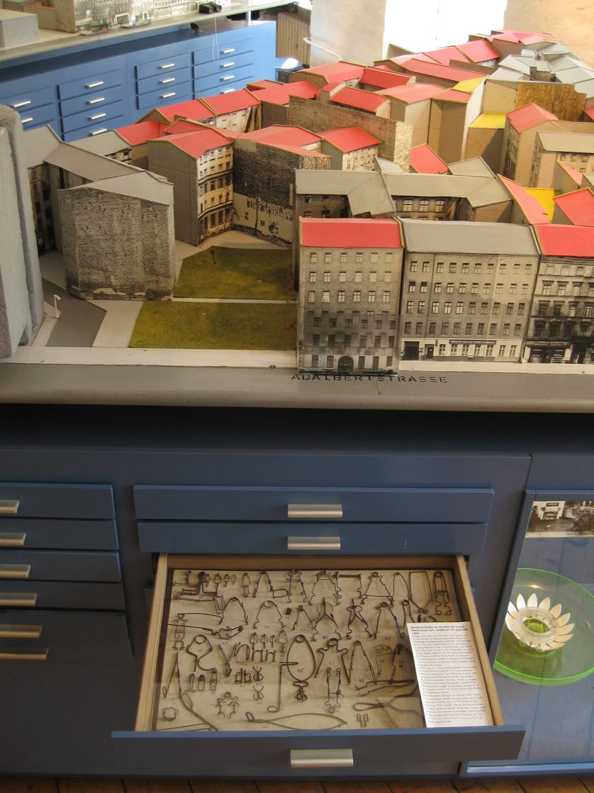

Slide 29
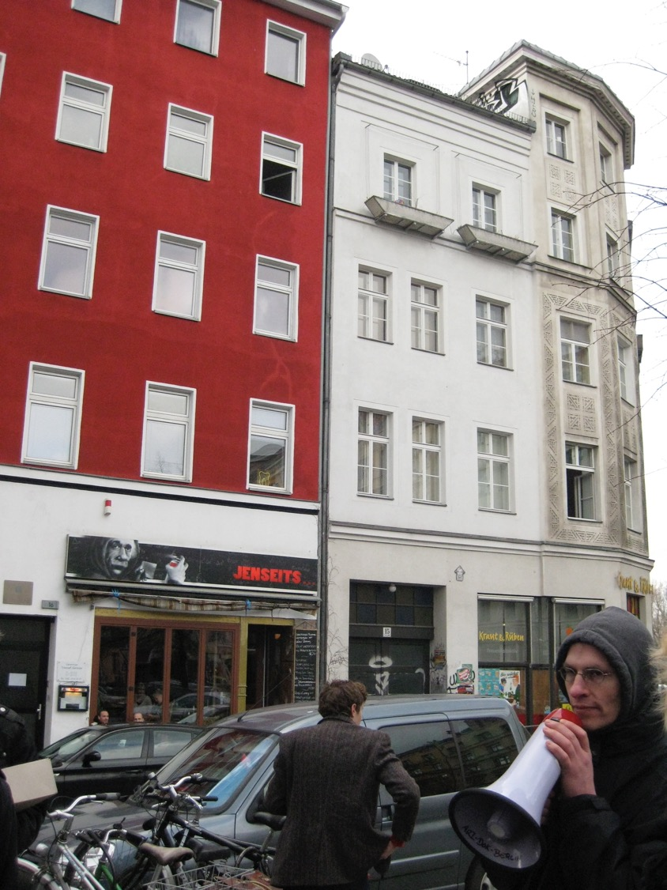

Slide 30
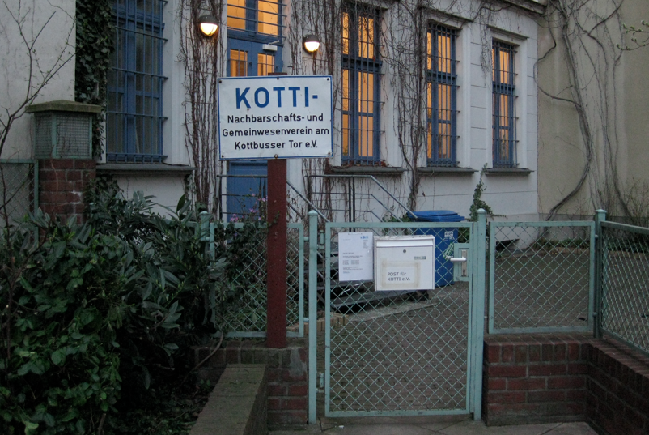

Slide 31
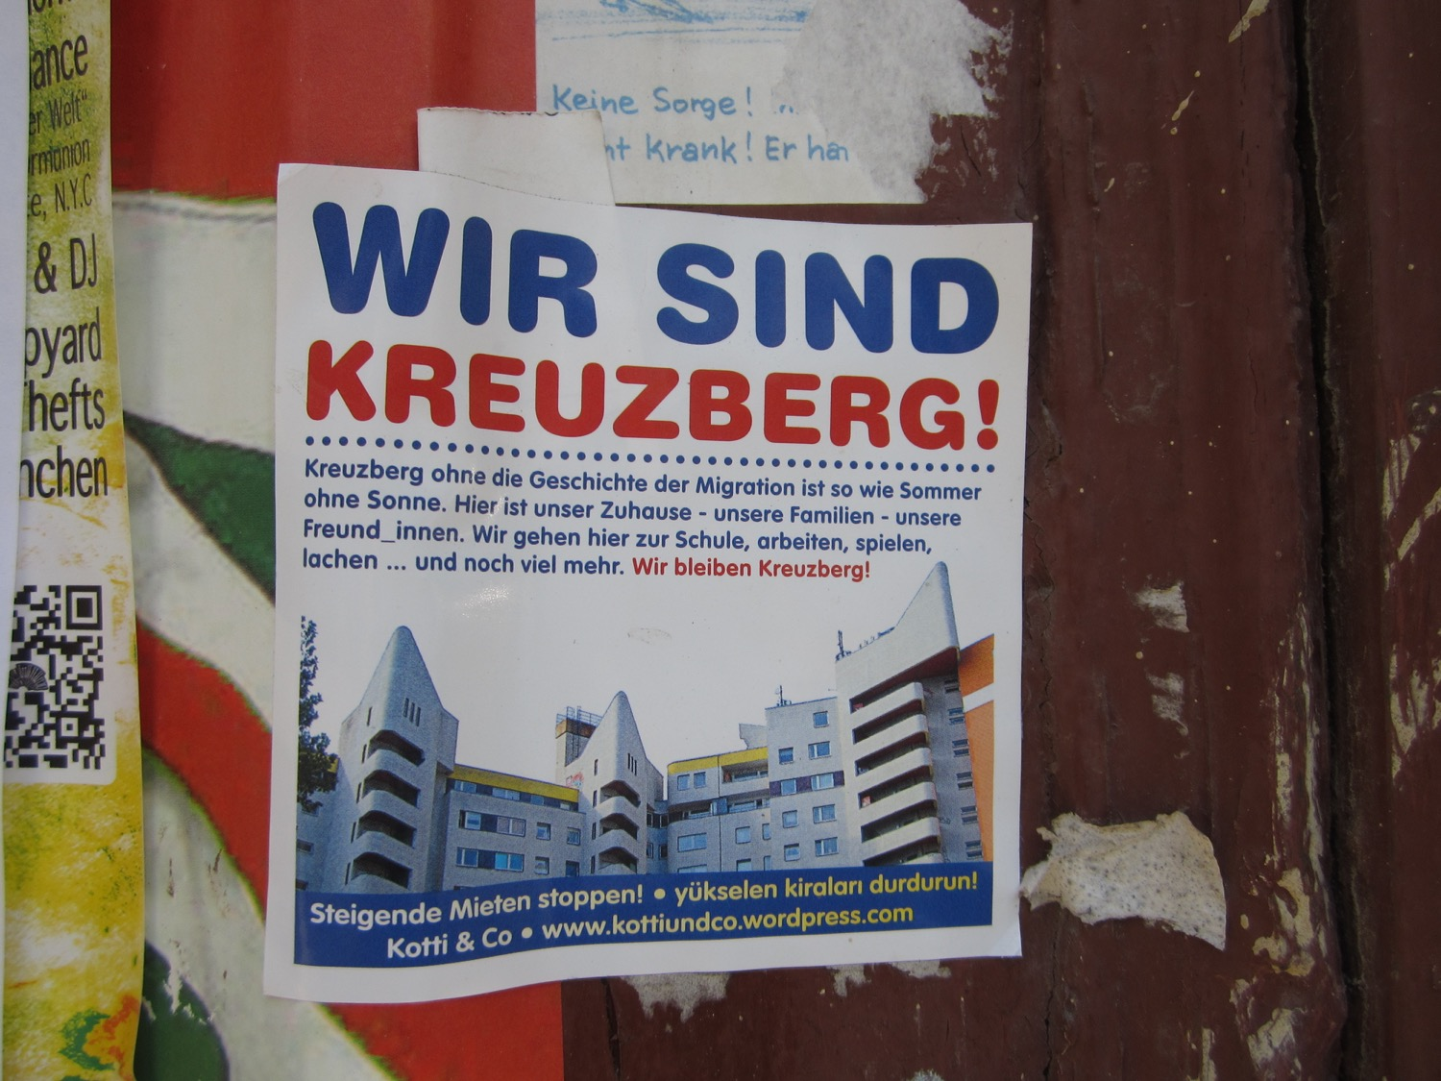

Slide 32
http://www.stolpersteine-berlin.de
http://www.fhxb-museum.de/index.php?id=82
http://www.fhxb-museum.de/index.php?id=322
http://www.fhxb-museum.de/index.php?id=264
http://www.fhxb-museum.de/index.php?id=305
http://www.fhxb-museum.de/index.php?id=28
http://www.fhxb-museum.de/index.php?id=27
http://www.fhxb-museum.de/index.php?id=287
http://www.fhxb-museum.de/index.php?id=268

Slide 33
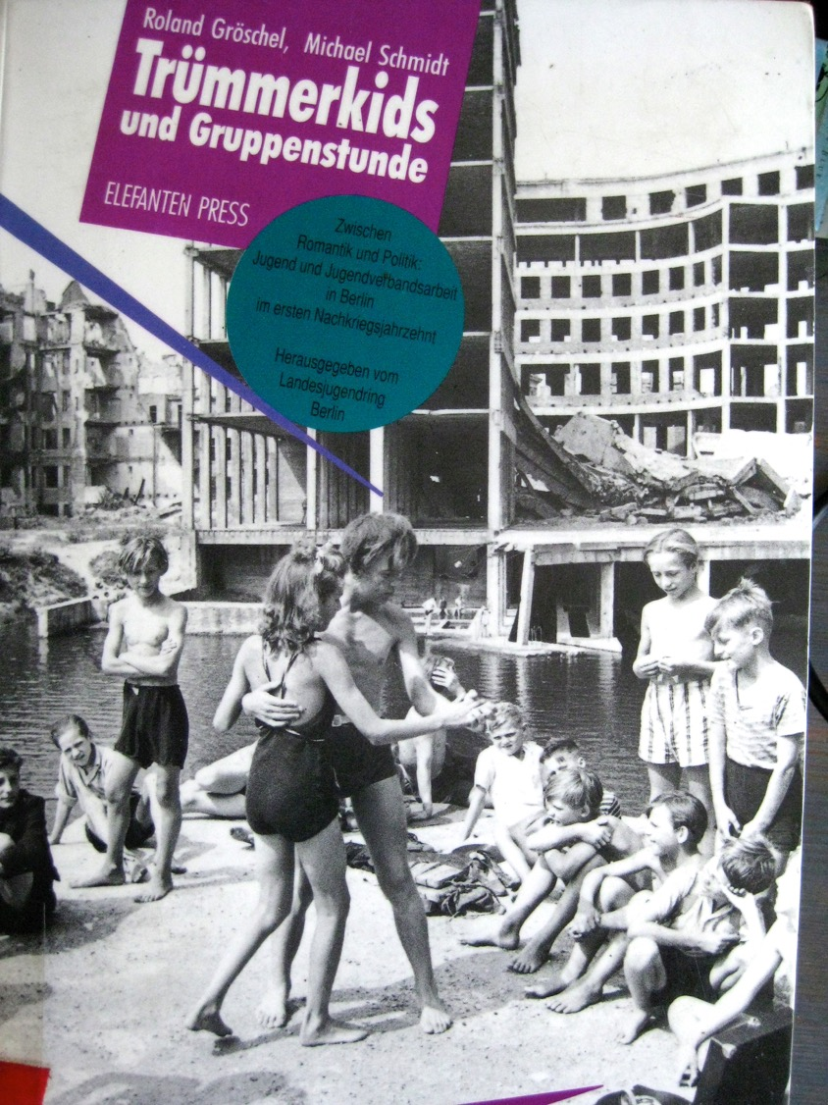

Slide 34
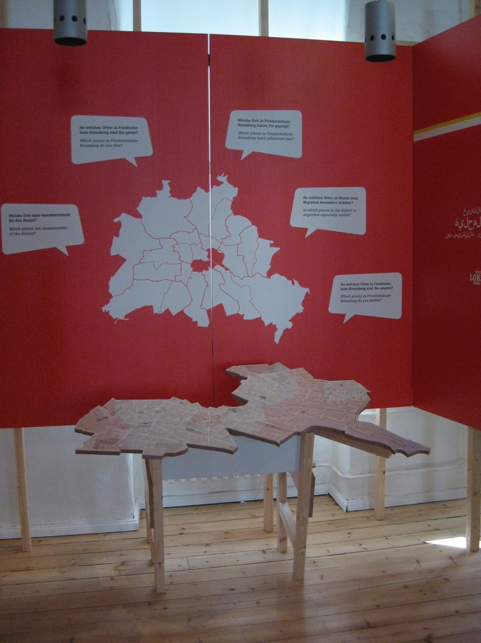

Slide 35
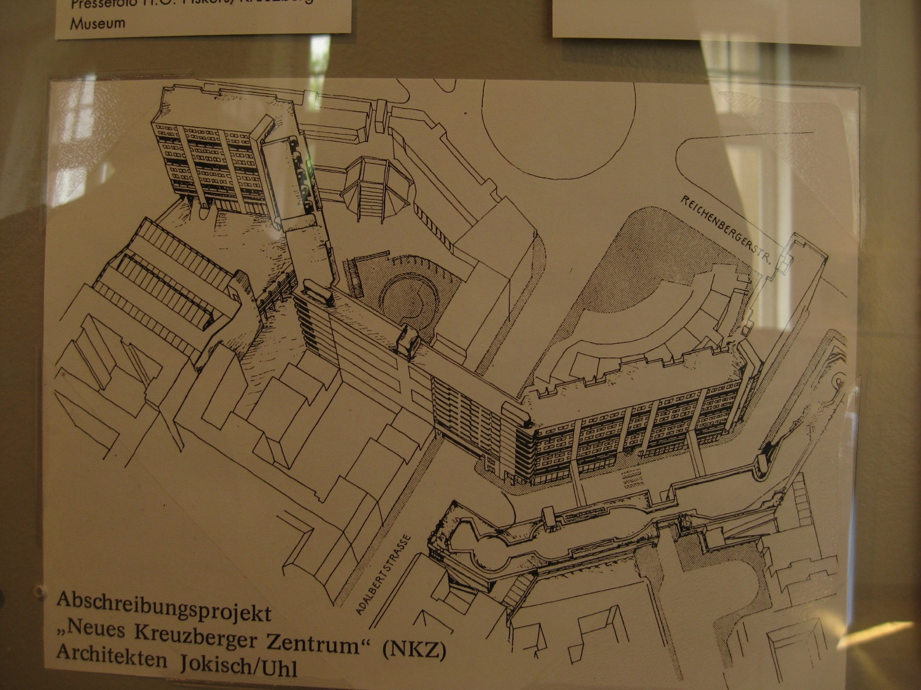
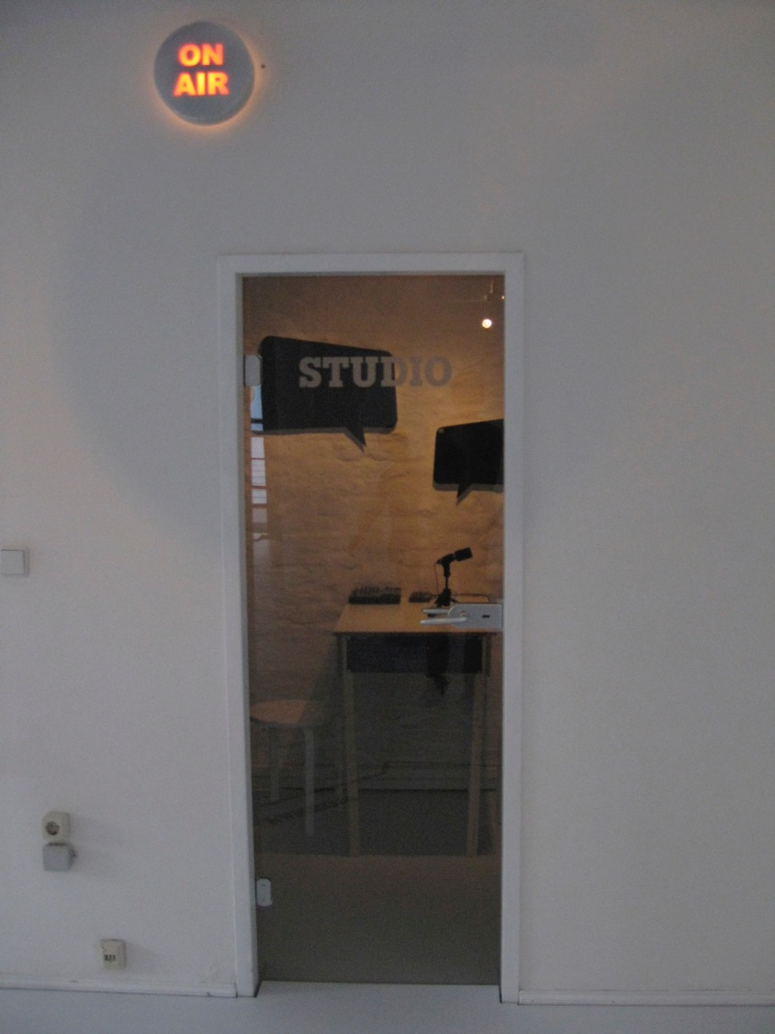
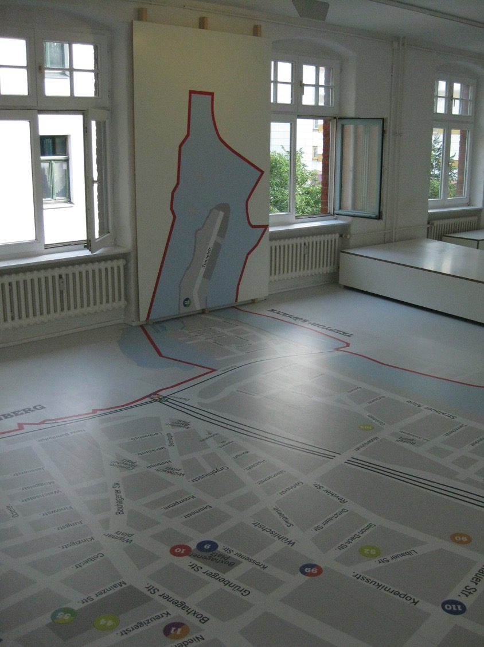
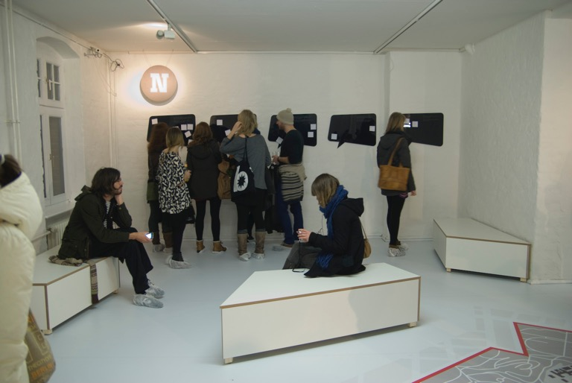
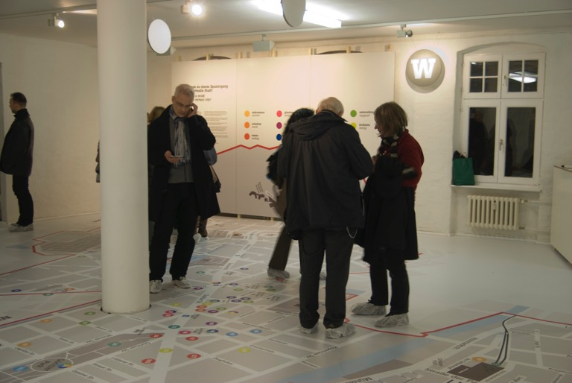

Slide 36
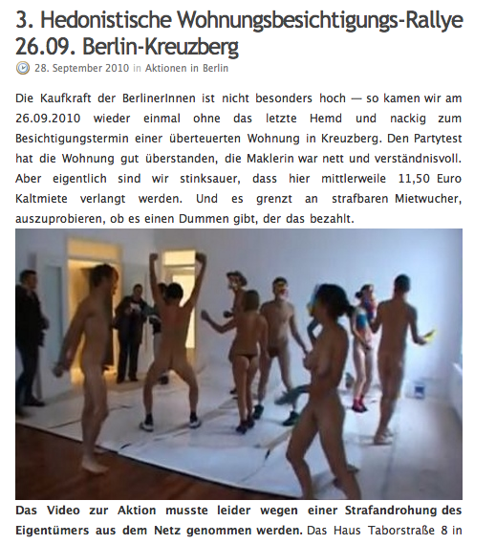
PARTY as resistance
against
exorbitant rents
http://wohnungsbesichtigungsrallye.blogsport.de/

Slide 37
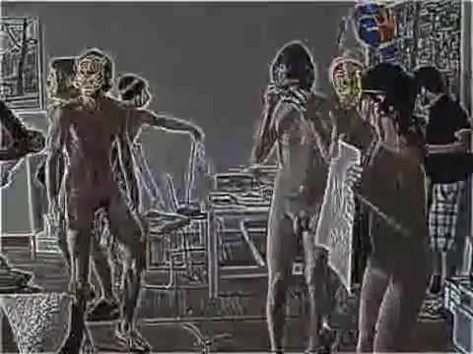
http://www.youtube.com/watch?v=D0Kaovpdn1k

Slide 38
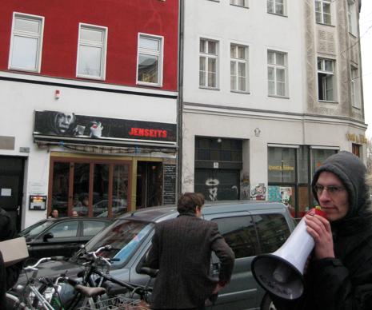
TEAKKER SA
(Danemark)
Fond d’investissement immobilier achète en 2009, 4000 appartements
à Berlin. Teakker cherche à louer aux étudiants par Facebook
pour une période de 2 ans
GENTRIFICATION TOUR
KREUZBERG, BERLIN
March 2011
http://www.taekker.de/

