Slide 1
The emotional aspects regarding the professional development of physical education teachers in training (PETTs): Methodology and results
Magali Descoeudres, University of Teacher Education, Lausanne, Switzerland,
9th October 2017
magali.descoeudres@hepl.ch

Slide 2
Presentation’s plan
1. Introduction
2. The PETT and the emotional aspects of the teaching profession
3. Research questions
4. Method
5. Data analysis
6. Results
7. Synthesis and discussion

Slide 3
1. Introduction
The present study is part of a research program which
-aims to better understand the professional development of PETTs through emotional moments during the PE lessons
-is based on the clinical activity (Vygotski, 1960) and on the French ergonomics
This study lies on qualitative data issue from questionnaires. Its specific purpose is to analyse on a large scale the types of emotional moments lived by PETTs and the emotions felt
Method: Grounded Theory (Strauss & Corbin, 1990)

Slide 4
2. The PETT and the emotional aspects of the teaching profession
The actions of a trainee teacher are most influenced by emotional moments from interactions with students and less by their course studies (Hascher & Hagenauer, 2016)
Many authors emphasize that trainee teacher react emotionally to interactive classroom experiences (Jokikokko, Uitto, Deketelaere & Estola, 2017)
The actions of trainee teacher are a crossroad of intense emotions (Schutz, 2014), most notably those related to dilemmas (Lassila & Uitto, 2016; McKay, 2016), to unpredictability (Bullough, 2009) and to the shock of reality (Kim & Cho, 2014, De Mauro & Jennings, 2016).
Notes:
General: We use the term teacher in training in our research. Because our participants are still studying education and have not graduate. In the literature the terms ‘beginning teacher’ , ‘novice teacher’ (Fantilli & McDougall, 2009), student teacher, ‘early career teacher’ (Hulme & Menter, 2014), ‘newly qualified teacher’ (Ulvik & Langørgen, 2012) and ‘first-year teacher’ (Hebert & Worthy, 2001) are used.
1. It’s more intense for the PEETs to practice teaching than to participate to the lectures at the teacher university…
2. Schutz (2014): the classroom context involves both the extreme happiness and joy from a lesson that goes as planned to the intense frustration of working with a challenging student.
3. Dilemmas: should the PETT manage their students or should he either make them learning, or both?
Unpredictability: some authors say that sometimes more than 80% of the lesson time is used to manage unpredictability
Shock of reality: before they start teaching the PETT thinks that their students will be engaged in the activity for example… Like them when they were students during PE lessons, engaged...

Slide 5
3. Research questions of this study
1. What types of emotional moments live the PETTs in a class setting during their first year at the University of teacher education?
2. What links exist between those emotional moments and the different types and different intensities of emotions ?
3. With whom those emotional moments are discussed ?
4. What effect those emotional moments on the PETT?
Notes:
A mixed research design based on a questionnaire on the one hand and on the clinical activity procedure on the other hand was adopted. In this paper we will focus on the first method.
What’s an emotional moment? Something unexpected that happened in a PE lesson, a situation that the PETT remember and where the PETT feel an emotion

Slide 6
4. Method based on questionnaires
Participants and context:
  to date, 98 PETTs, students of the HEP
  alternative education school
Questionnaire (30 minutes):
  relate 2 emotional moments during a PE lesson (196 emotional moments)
  identify the emotion and the intensity felt
  was this experience discussed with others (who?)
  did this experience have an effect on your teaching?
Notes:
1. The data presented is taken from questionnaire responses by 98 PETT’s at the University of Teacher Education in Lausanne (Switzerland). The students are all physical education specialists. They graduated at the University of Lausanne in Sport Science and they are now learning education at the University of teacher Education. The 98 PETTs have different backgrounds, but most of them (70%) made replacements in school and experienced emotional events, even before coming to the education center. In the questionnaire they had to write two emotional situations they lived during teaching. The questionnaire took into consideration three main areas of significance: immediate impact of an event as well as the emotion and the degree of the emotions experienced from the event. We inquire also with whom those emotion from emotional moments are discussed and the effects.
2. Context:
Once or twice a week the students teach to classes supervised from a tutor. The rest of the time they have lectures at university. It seems they live emotional intense moments during teaching and less intense emotional moments when they are at university.
ATTENTION: DISTRIBUER LE QUESTIONNAIRE !!!!
What’s an emotional moment? Something unexpected that happened in a PE lesson and the PETT remember and where the PETT felt an emotion

Slide 7
5. Data analysis
Coding emotional moments (Grounded Theory, Strauss & Corbin, 1990): open coding-> axial coding -> selective coding
Links between the emotion, intensity and the type of emotional moment?
Follow up effects from the lived emotional moments?
➔ This part allows, on a large scale, to know the types of emotional moments that PETTs live in PE lessons, the emotions that are associated with and if those emotional moments are shared with others.
Notes:
In order to evaluate this data, the 196 responses were categorized according to the procedures of the Grounded Theory (Strauss & Corbin, 1990). Two researchers worked together, step by step, meeting after meeting, week after week
Coding is the fundamental analytic process used by the researcher. In grounded theory research, there are three basic types of coding: open, axial and selective.
A Grounded Theorist Need Not Work Alone.

Slide 8
6. Results: emotional moments written by PETTs
Positive emotional moments | 53 | 27.55%
Negative emotional moments | 128 | 64.80%
Emotional moment, first negative, then positive | 15 | 7.65%
Total | 196 | 100%
Notes:
Physical education teacher in training live more negative (64.8%) emotional moments than positive emotional moments (27.55). Some emotional moments are negative at the beginning, but at the end the issue is positive (7.65%). The emotions with negative feelings are sadness, anger and fear. The emotion with positive feeling is the joy. The surprise can be negative or positive depending on the situation. We choose to take the primary emotion from Parrott (2001), expect the emotion “love”.

Slide 9
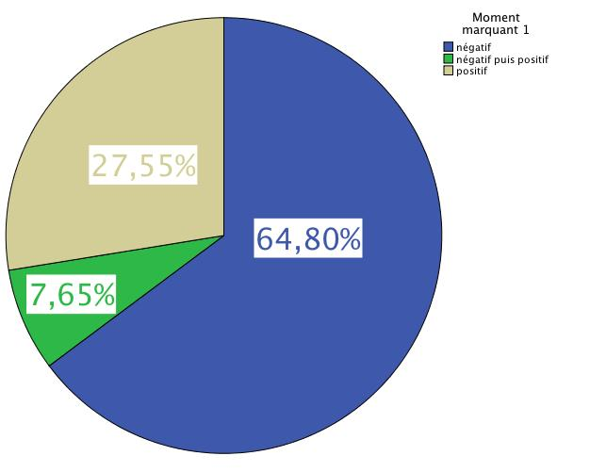

Slide 10
Axial coding example
(Grounded Theory, Strauss & Corbin, 1990)
Description emotional moment:
I wanted to work the high pass technique with my students. Often they are only motivated when playing Basketball. Thus, I was concerned how my lessons on high pass would happen. I was positively surprised during the first lesson because I created an uncertainty amongst the students. They understood that what I wanted to teach made sense and the result was that the lessons were great.
Sharing with others: spouse, parents
Effect 3: I realized that my students are able to do everything as long as learning made sense for them. If they understand my expectations, they are pleased to participate and are engaged in the learning.
In vivo coding: Understanding from the students about what is expected from the PETT and what makes sense
Axial coding one: Motivated students because of the framework implemented from PETT
Axial coding two: Engaged students
Selective coding: Feeling of empowerment

Slide 11
Axial coding example
(Grounded Theory, Strauss & Corbin, 1990)
Description emotional moment:
Second week full time, I had to substitute my tutor in a class of boys which I had already observed once, but never taught. The theme was endurance, a preparation of a twelve minutes test. The students were not attentive and did not respect my instructions. I quickly lost control of the class. We can say that the students took control and the objective was not achieved.
Sharing with others: Colleague, tutor, spouse
Effect 2: I take more time at the beginning of the lesson to explain my expectations and my goals. When a situation escalates a little out of control, I stop the lesson and bring together all the students to set the record straight before they can restart. During preparation of the lesson plan, I anticipate the needs according to the type of classes/students. This can result in more or less exercises, adapted instructions, time… In vivo coding: Loss of control of the class. Students taking control
Axial coding one: Transgression to environment of collective opposition
Axial coding two:
Rules transgression from one or more students
Selective coding
Feeling of helplessness
Notes:
For each of the 196 emotional moments the researchers did those codings.
In the questionnaire, the participants have also to write their emotion and the intensity they felt.

Slide 12
Axial coding second level | Selective coding | Total
1. Gap with the teamwork | Lack of recognition | 3
2. Lack of complicity between the PETT and the students | Lack of recognition | 7
3. Inclusion with the teamwork | Recognition | 2
4. Complicity between the PETT and the students | Recognition | 7
5. Event implicating physical integrity | Feeling of helplessness * except 1x (from negative to positive, it’s feeling of empowerment | 43 1
6. Unmotivated students | Feeling of helplessness | 6
7. Unpredictability | Feeling of helplessness * | 3 1
8. Rules transgression from one or more students | Feeling of helplessness * | 53 3
9. Differentiation from PETT | Feeling of helplessness (13) | 13
 | Feeling of empowerment (6) | 6
10. Motivated students | Feeling of empowerment | 27
11. Students learning | Feeling of empowerment | 20
12. No unpredictability | Feeling of empowerment | 1
Notes:
Axial coding and selective coding
The axial coding is composed of 12 categories .
The selective coding is composed of 4 categories.

Slide 13
Core category
Selective coding | Occurrences | Percentages
Feeling of helplessness | 128 | 65.31 %
Lack of recognition | 3 | 1.53 %
Feeling of empowerment | 56 | 28.57 %
Recognition | 9 | 4.59 %
Total | 196 | 100%

Slide 14
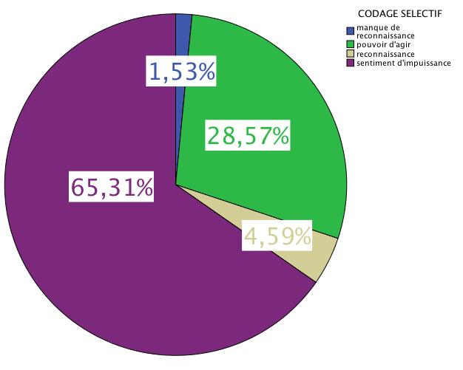

Slide 15
Core category
Recognition
Feeling of helplessness
Feeling of empowerment
Lack of recognition
Notes:
All situations can be placed on those two axes on one or two lines or between those lines when those situations are concerning both problematics

Slide 16
Answer research questions
1. What types of emotional moments are present by the PETT in a class setting during their first year at the University of teacher education?
Negative emotional moments:
Rules transgression from one or more students (56/ 196)
Event implicating physical integrity (44/196)
Positive emotional moments:
Motivated students (27/196)
Students learning (20/196)
Notes:
All situations can be placed on those two axes on one or two lines or between those lines when those situations are concerning both problematics

Slide 17
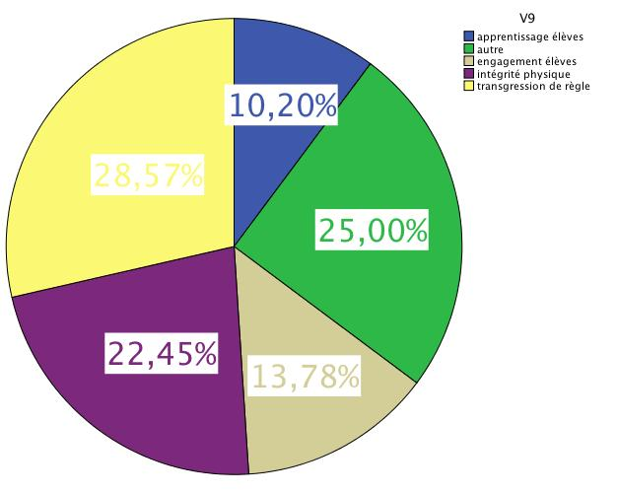

Slide 18
Answer research questions
2. What links exist between those emotional moments and the different types and different intensities of emotions ?
The surprise is felt more than 80 %
Anger: 43.36 %
Joy: 32.14 %
Fear: 27.54 %
Sadness: 27.54 %
Notes:
The emotion joy is linked to the feeling of empowerment.
Instead of this, fear, sadness and anger are linked to the feeling of helplessness.
The surprise can be present by positive or negative moments.
The surprise is present in more then 80 percent of the emotional moments evocated by the PETTs.
Anger is present in 43.36 percent.
Joy is present in 32.14 of the case.
Fear is present in 27.54 percent.
Sadness is present in 27.54 of the case.

Slide 19
Intensity of emotions
Emotion | Intensity 1 | Intensity 2 | Intensity 3 | Total
Surprise | 33 | 67 | 57 | 157 / 196
Anger | 24 | 43 | 18 | 85 / 196
Joy | 2 | 19 | 42 | 63 / 196
Fear | 19 | 21 | 14 | 54 / 196
Sadness | 24 | 19 | 11 | 54 / 196
Total | 120 | 162 | 152
Notes:
Regarding the intensity of the emotion, it’s difficult to draw the rights conclusions.
When the PETTs feel joy, this joy is in a quiet strong intensity. The sadness is felt in a low intensity.
Anger is felt in a middle intensity.
Surprise is felt high or in the middle.

Slide 20
Answer research questions
3. With whom those emotional moments are discussed ?
184 / 196 emotional moments lived by PETT are shared with others
With the tutor: 101 / 196 (51.5 %)
With colleague: 101 / 196 (51.5 %)
With the hierarchy: 26 / 196 (13.3 %)
With the spouse: 70 / 196 (35.7%)
With a friend: 60 / 196 (30.6 %)
Notes:
Almost all emotional moments lived by the PETTs are shared with somebody. Half of them are shared with the tutor or with the colleagues. Just a few of them are shared with the hierarchy and a certain number are shared with the spouse or with friends.

Slide 21
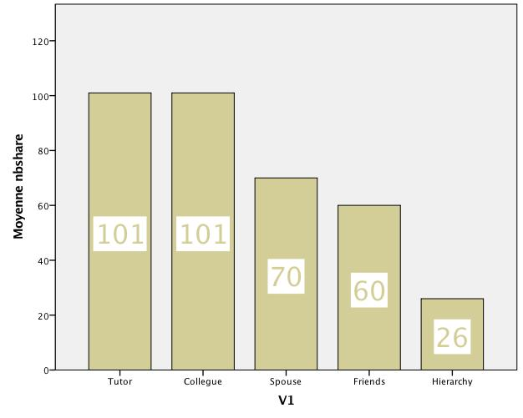

Slide 22
Answer research questions
4. What effect those emotional moments on the PETT?
163 emotional moments lived by PETTs have an influence on the continuation of the teacher profession
Intensity effect 1: 63
Intensity effect 2: 65
Intensity effect 3: 35
The PEETs react mostly positively after what happened
Notes:
It means that the PETTs change something after this emotional moment. The change, the adaptation after an emotional moment can be in the lesson plan, in the way they organize the lesson, or how they give instructions. Sometimes it’s also in the activity… The PEETs react mostly positively after what happened

Slide 23
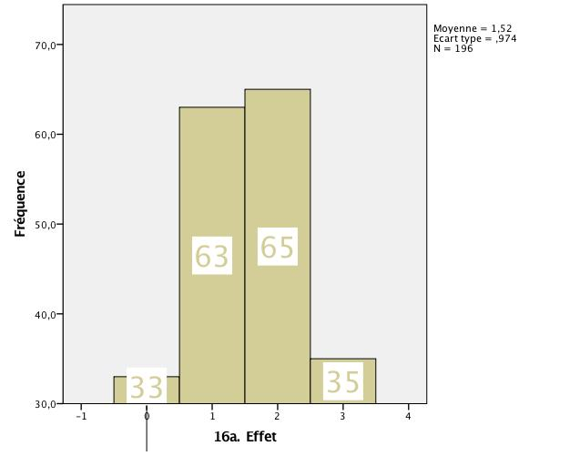
Notes:
Just 33 moments don’t have an effect on the PETT

Slide 24
7. Synthesis results and discussion
The actions of trainee teacher are a crossroad of intense emotions (Schutz, 2014)
Most of the emotional moments lived by PETTs are negative and linked with classroom situations. There are also a lot of positive (1/3).
Chen (2016) found that most pleasant emotions are related to classroom and collegial interactions, whereas the unpleasant ones are associated with educational policy, changes, and imbalance in teachers’ lives -> this study shows that negative emotions are all linked with classroom situations
The surprise is strongly present in the trainee teachers activity (Ria, 2005). It leads to the shock of reality (Kim & Cho, 2014, De Mauro & Jennings, 2016), to unpredictability (Bullough, 2009). PETTs need to adapt themselves to the lived situation.

Slide 25
Synthesis results and discussion
Primary emotions (Parrott, 2001) are felt more or less. Joy is felt when students are engaged (Chen, 2016), when students learn and when they growth (Hagenauer & Volet, 2014)
Those moments lead to dilemmas (Lassila & Uitto, 2016; McKay, 2016) : should the PETTs manage the students or engaged them in the learning? Or both?
Sharing with others seems here to be very important (Lindqvist, 2017). Jokikokko (2017) found that beginning teachers adopt the strategy of silence when they live an emotional situation. Lassila (2016) told that relationship with a senior colleague can be source for tensions. This study shows that sharing with others is part of profession.
Notes:
Sharing with others:
relationships with one’s senior colleagues can be a source for tensions. The colleagues can have an effect upon how teachers interact with their students, for instance, by interrupting the lesson to give advice or urging them to teach and interact in a certain manner (Miyajima 2008).
Lindqvist, 2017:
Student teachers talked about seeking guidance as a tactic in resolving their professional inadequacy at the beginning of their teaching careers. The more experience they gain, the less support they need.

Slide 26
Conclusion
This study is a photography about emotional moments lived by the PETTs in early carrier
Emotions are always present by teaching (Hargreaves, 1998). What is really interesting now is to understand how this subjective emotional part of the profession contribute to the PETTs professional development
→ qualitative longitudinal study with the follow up of 5 PETTs during one year allows the researcher to know more about the PETTs professional development
Notes:
The data collecting lasted one year. 5 PEETs have been followed during one year. Each time the lived an emotional moments in their PE lesson, the called the researcher and they did a self confrontation interview. For this part of the study, the theoretical framework is the clinical activity and also the French ergonomics.

Slide 27
Bibliographie
Bullough, R. V. (2009). Seeking Eudaimonia: The emotions in learning to teach and to mentor. In P. A. Schutz, & M. S. Zembylas (Eds.), Advances in teacher emotion research, 33–53.Dordrecht: Springer.
Chen, J. (2016). Understanding teacher emotions: The development of a teacher emotion inventory. Teaching and Teacher Education, 55, 68-77.
De Mauro A.A & Jennings, P.A. (2016). Pre-service teachers’ efficacy beliefs and emotional states. Emotional and Behavioural Difficulties, 21(1), 119-132.
Hagenauer, G., & Volet, S. E. (2014). I don't hide my feelings, even though I try to: insight into teacher educator emotion display. Australian Educational Researcher, 41, 261-281.
Hargreaves, A (1998). Hargreaves, A. (1998). The emotional practice of teaching. Teaching and Teacher Education, 14(8), 835-854.
Hascher, T. & Hagenauer, G. (2016). Openness to theory and its importance for pre-service teachers’ self-efficacy, emotions, and classroom behavior in the teaching practicum. International Journal of Educational Research, 77, 15-25.
Jokikokko, K., Uitto, M., Deketelaere, A. & Estola, E. (2017). A beginning teacher in emotionaly intensive micropolitical situations. International Journal of Educational Research, 81, 61-70.
Kim, H., & Cho, Y. (2014). “Pre-Service Teachers’ Motivation, Sense of Teaching Efficacy, and Expectation of Reality Shock.” Asia-Pacific Journal of Teacher Education, 42(1), 67–81
Lassila, E. & Uitto, M. (2016). The tensions between the ideal and experienced: teacher–student relationships in stories told by beginning Japanese teachers. Pedagogy, Culture & Society, 24(2), 205-219.
Lindqvist, H., Weurlander, M., Wernerson, A. & Thornberg, R. (2017). Resolving feelings of professional inadequacy: Student teachers’ coping with distressful situations. Teaching and Teacher Education, 64, 270-279.
Mac Kay, L. Loraine (2016). Beginning teachers and inclusive education: frustrations, dilemmas and growth, International Journal of Inclusive Education, 20,(4), 383-396.
Parrott, W. (2001), Emotions in Social Psychology, Psychology Press, Philadelphia
Ria, L. (2005), coordonné par Ria. Les émotions. Pour l’action.
Schutz, P. A. (2014). Inquiry on teachers' emotion. Educational Psychologist, 49(1), 1-12.
Strauss, A.L., Corbin, J. (1990). Basics of Qualitative Research: Grounded theory Procedures and Techniques. Newbury Park: Sage.
Vygotski, L.- S. (1930-31/1960). Histoire du développement des fonctions psychiques supérieures. Moscou.

